Slide 1
Space Shooter
Use Unity 3D engine
Ren Sheng

Slide 2
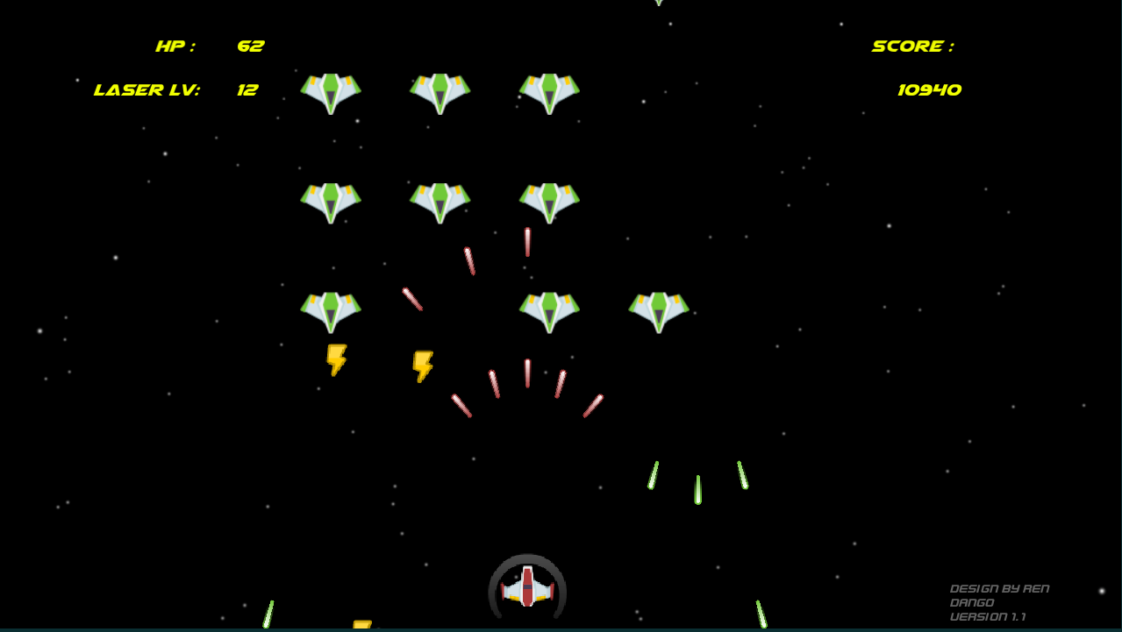
About the Space Shooter
What is this?
-A 2D space shooting game.
What is the goal of make this game?
-For player to have fun.
What platform does it support?
-PC, Android(API24), WebGL.
Is it hard to make this game?
-No.

Slide 3
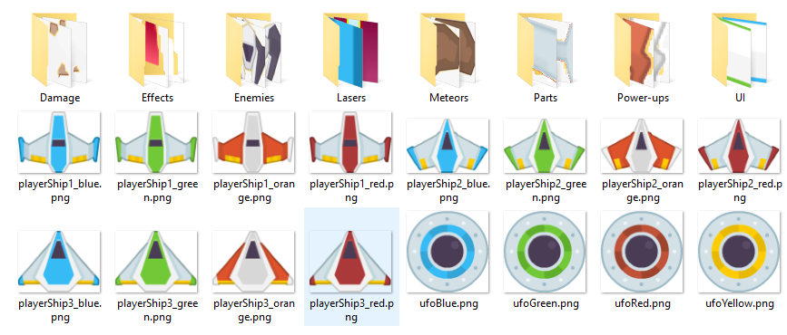
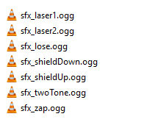
Assets
Sprites and sound are download from www.kenney.nl
Credit to Kenney or www.kenney.nl.

Slide 4
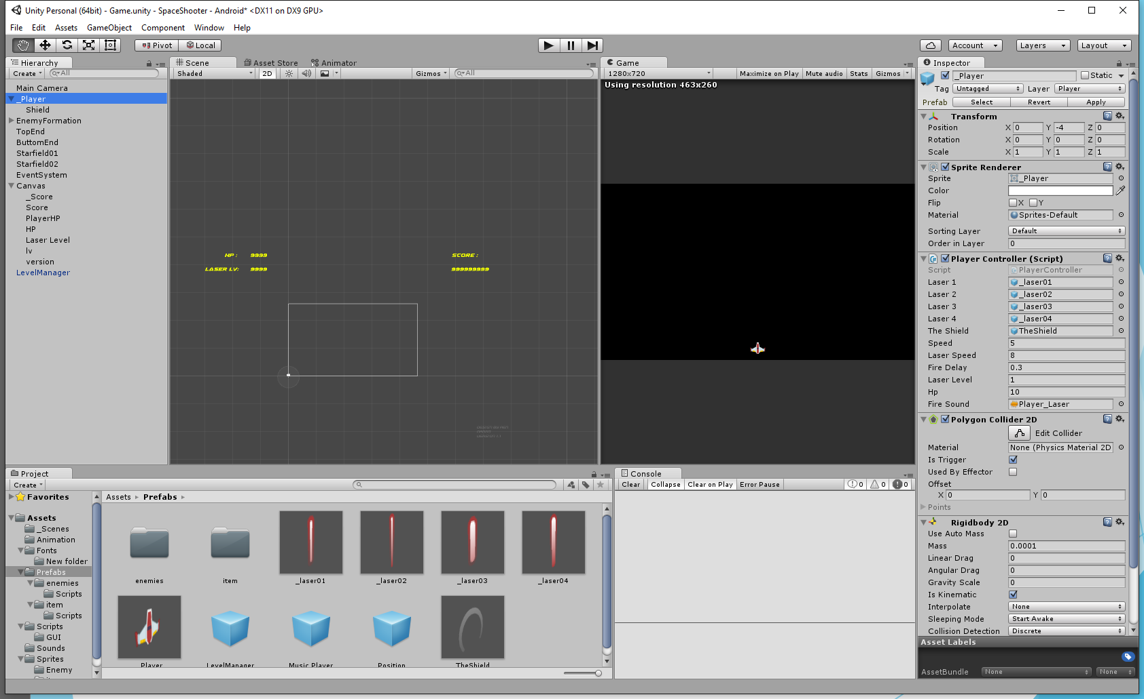
Unity Engine

Slide 5
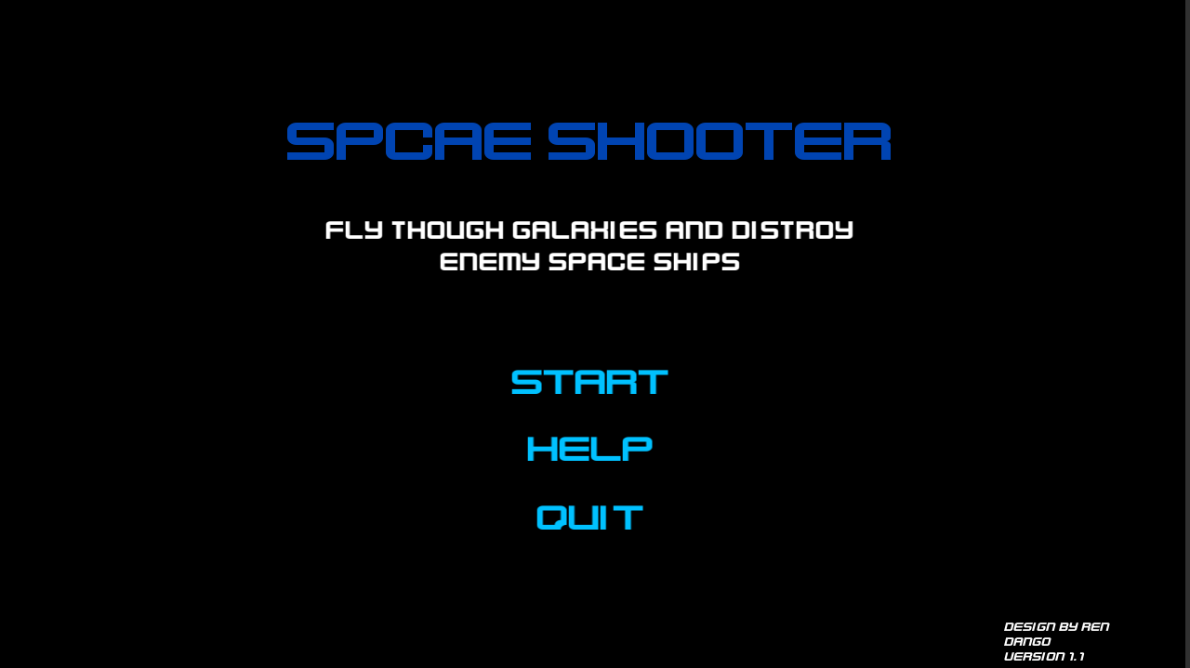
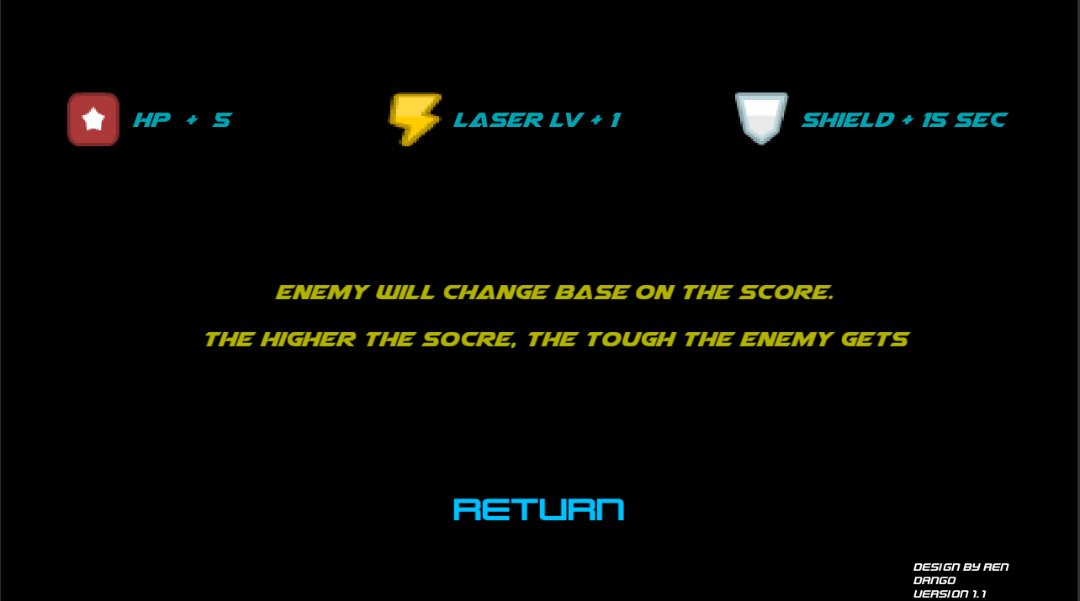
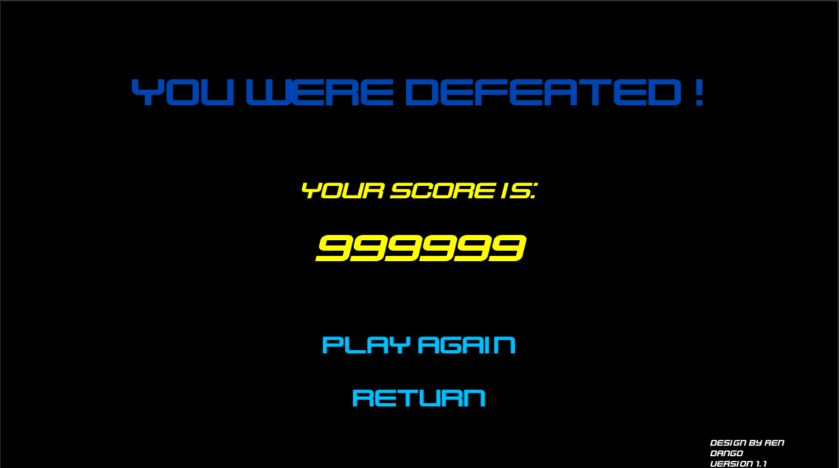
Scenes

Slide 6
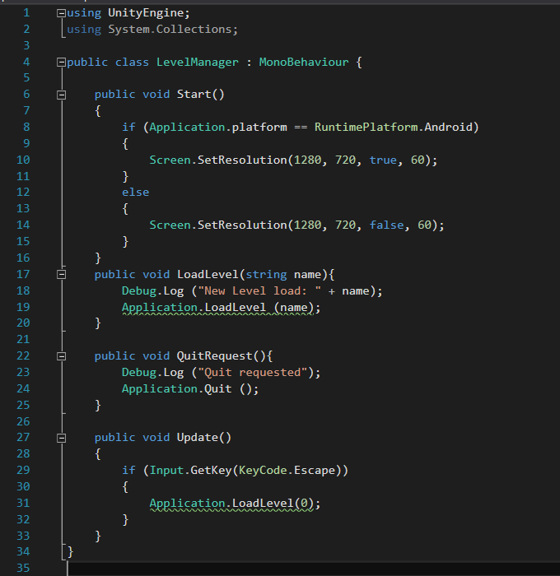
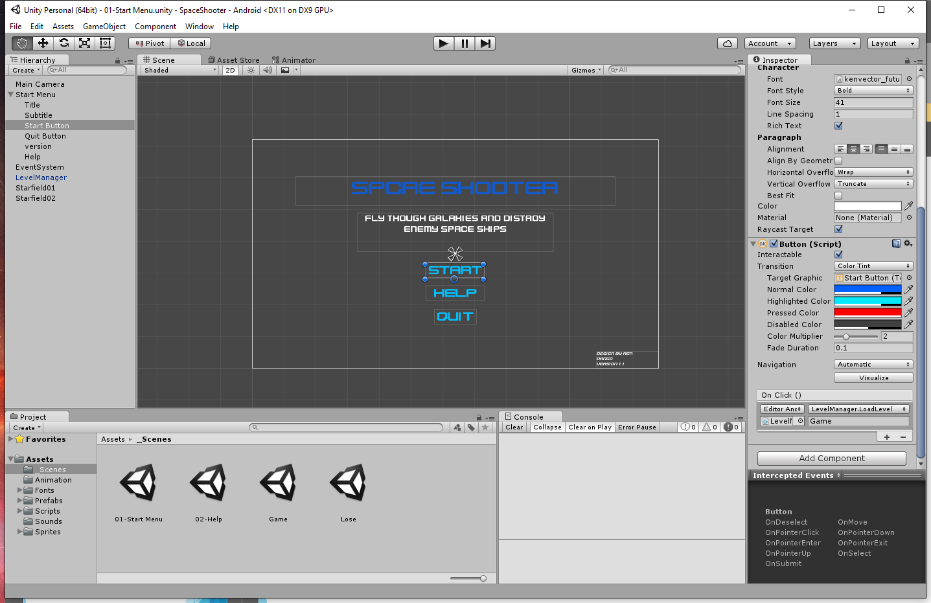
Menus and LevelManager

Slide 7
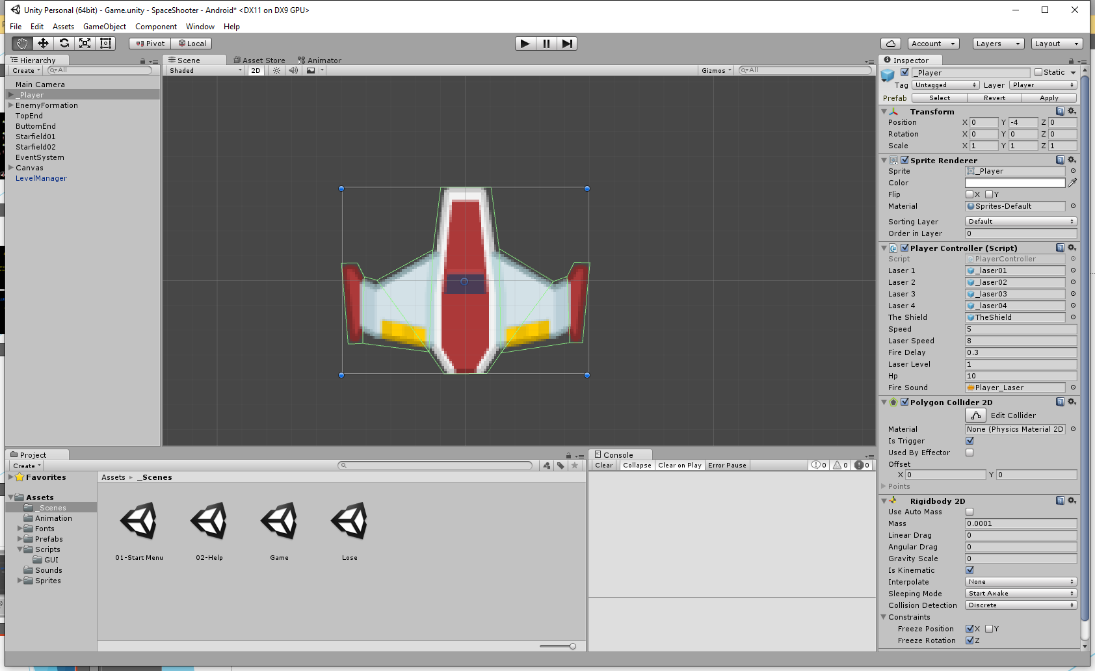
PlayerController

Slide 8
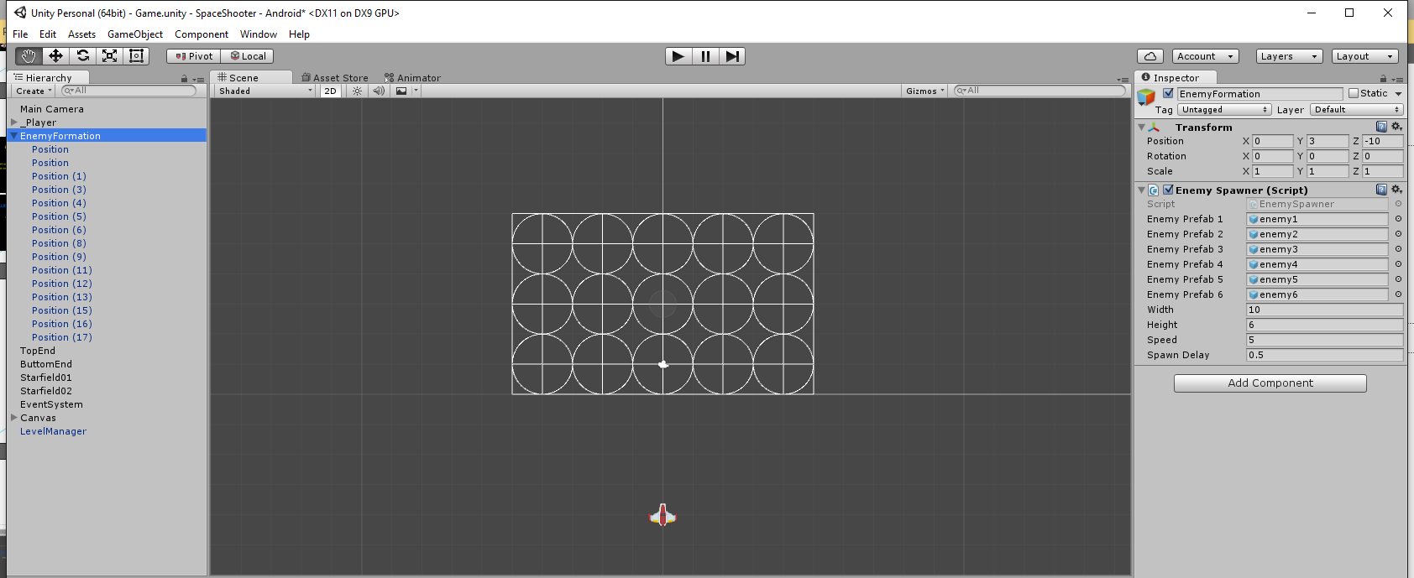
EnemySpawner and EnemyBehaviour

Slide 9
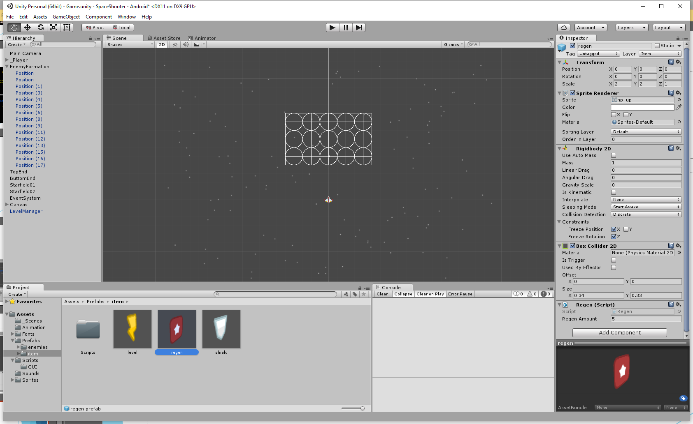
Items

Slide 10
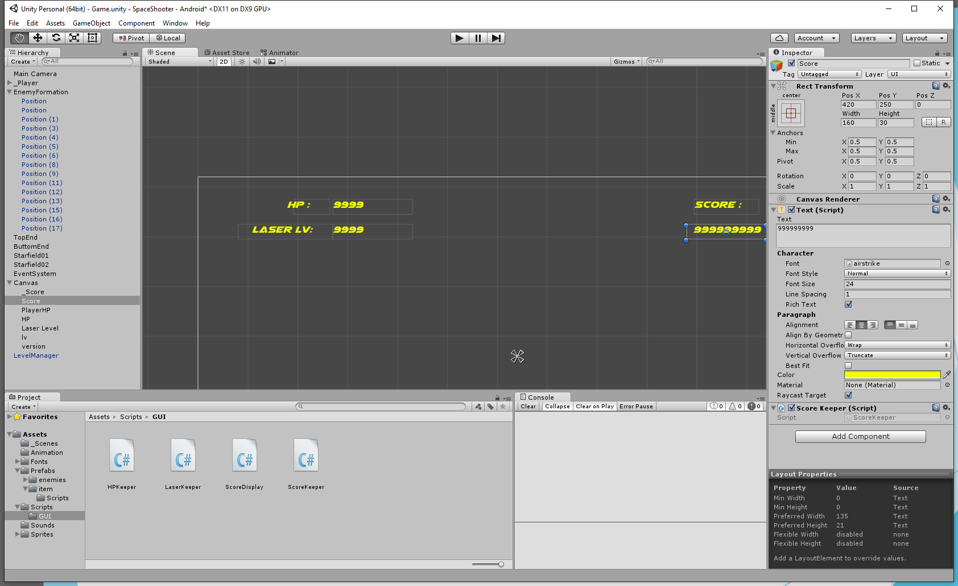
UIs-Score/HP/LaserLevelKeeper

Slide 11
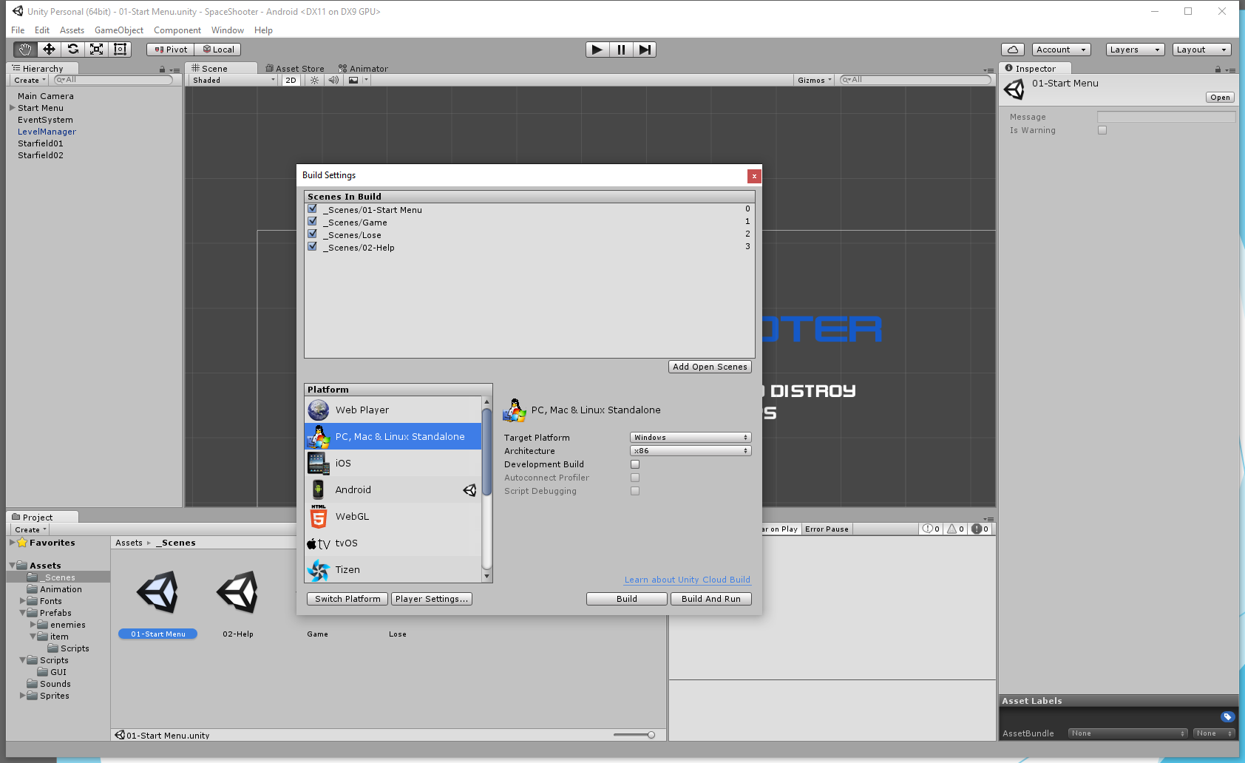
Build for Different Platform

Slide 12
Thank You!
Ren Sheng

